Slide 1



Topic: Smart Coatings Questionnaire
Rahul Rajwar
Chemical/Petroleum Engineering
IIT Kharagpur
Arghadeep Biswas
Chemical Engineering
IIT Kharagpur

Slide 2

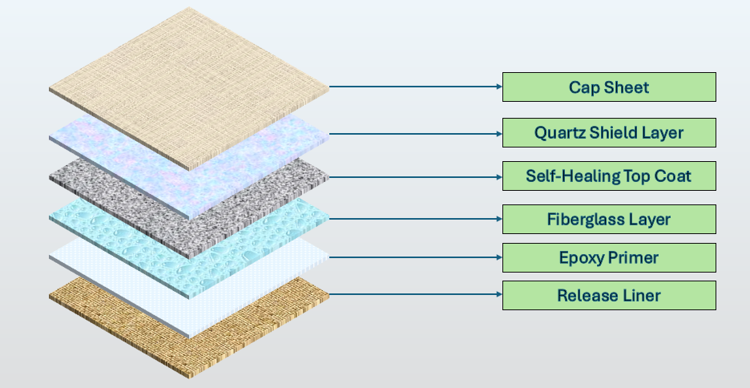
Q.1) Explain how your idea is unique in comparison with the literature. Check whether a commercial product is available of similar nature. Give
advantages and disadvantages of proposed coating system over other reported coating systems. Clearly define the end use of the proposed coating.
Uniqueness of our Proposed Smart Coating System
Novelty: Provides active water resistance with breathability, preventing mold and algae
Uniqueness: Combines hydrophobicity and vapor permeability, unlike silicone-based coatings
Quartz Shield Layer
Self-Healing Top Coat
Novelty: TiO₂-based polyurethane autonomously repairs microcracks under mild heat exposure
Uniqueness: Flexible activation, outperforming systems needing specific heat input
Fiberglass
layer
Novelty: Reinforces mechanical strength, thermal resistance, and structural durability
Uniqueness: Rarely used in coatings, ideal for extreme industrial and coastal stress
Epoxy
Primer
Novelty: Combines anti-corrosion properties with dual adhesion for strong bonding
Uniqueness: Acts as a sacrificial layer, preventing substrate degradation effectively
Comparison with Commercial Products
Advantages Over Other Reported Coating Systems
Feature | Our System | Existing Products
Waterproofing
Strength
Self-Healing
Aspect
Proposed System
Conventional Systems
Hydrophobic silicone agents
(e.g., Asian Paints SmartCare)
Quartz Shield ensures water
resistance and breathability
Quartz-based with breathability
Water Resistance
Silicone-based, no breathability
Fiberglass layer enhances
mechanical strength
Basic coatings prone to cracking
under stress
Most paints lack
structural reinforcement
Mechanical Strength
Fiberglass reinforcement
Sustained up to 7 years with
thermal activation
Thermal activation with TiO₂
works at mild heat
Limited to controlled heat
environments​
Nanomyte MEND 1000
requires specific heat input​
Self-Healing Efficiency
Zinc phosphate sacrificial
properties
Decora lacks primer
functionality
Basic epoxy primers without
sacrificial benefits
Zinc phosphate epoxy primer
with sacrificial properties
Corrosion Inhibition
Corrosion Protection
Urea-urethane coatings like
Protech NH-290 lack specific
thermal resistance​
Fiberglass and Quartz Shield
protect against extremes
Solvent-based coatings with high
VOC emissions
Thermal Resistance
Environmental Impact
Low-VOC, waterborne system

Slide 3
Q.1) Explain how your idea is unique in comparison with the literature. Check whether a commercial product is available of similar nature. Give
advantages and disadvantages of proposed coating system over other reported coating systems. Clearly define the end use of the proposed coating.
Provides self-healing functionality
for microcrack repair
Higher initial cost compared
to conventional coatings
Offers superior corrosion
resistance with zinc primer
Requires precise application
techniques for layer performance
Provides self-healing
functionality for microcrack repair
Advantages
of Our
Proposed
Coating System
Disadvantages
of Our
Proposed
Coating System
Combines water resistance and
breathability effectively
Limited performance under
extremely high mechanical impact
Enhances structural durability
using fiberglass reinforcement
Complex multi-layer process
increases production time
Extends lifespan, reducing
maintenance. reapplication costs
May need specific environmental
conditions for curing
Defined End-Use Applications
Construction
Industrial and Coastal
Automotive and Aerospace
Residential Use
Target Areas: Building facades, rooftops, and interior walls in humid or corrosive environments
Benefits: Reduced maintenance, enhanced durability, and mold resistance
Target Areas: Oil pipelines, storage tanks, and marine equipment
Benefits: Corrosion resistance, mechanical strength, and extended operational lifespan
Target Areas: Vehicle exteriors and aircraft fuselages
Benefits: Scratch resistance, thermal protection, and aesthetic durability
Target Areas: Kitchens, bathrooms, and basements
Benefits: Mold resistance, easy cleaning, and reduced reapplication

Slide 4
Q.2) What is the expected durability/life of the coating? How long will the smart property sustain?
Environmental Durability
Summary of Durability by Layer
Expected Lifespan
Environment
Layer
Key Contributions
Key Features
Expected Lifespan
Resistant to humidity, algae,
salt, and mold
5-7 years
Coastal Areas
Quartz Shield Layer
Water resistance, breathability,
prevents mold and algae
7-8 years
Resists corrosion, pollutants,
and mechanical stress
4-6 years
Industrial Environments
Self-Healing Topcoat
Thermal-activated self-repair
with 80-90% healing efficiency
5-7 years
Maintains structural integrity
and breathability
Cold Climates
Structural reinforcement and
Puncture resistance
6-8 years
Fiberglass Layer
8-10 years
Epoxy Primer
Strong substrate adhesion
and anti-corrosion properties
7-10 years
Comparison of Proposed Smart Coating System with Other Coating Solutions
Proposed Smart
Coating
Asian Paints
SmartCare
Asian Paints
Decora
Overall System
Comprehensive protection with
synergistic layer interactions
Protech
NH-290
8-10 years
Property
5 years
(waterproofing)
6 months
(limited shelf life)
3 years
(acrylic co-polymer)
8-10 years under
normal conditions
Durability
Sustainability of Smart Properties
Years 1-3 | 90-95% | 100% | 100%
Years 3-5 | 80-85% | 95% | 95%
Years 5-7 | 60-70% | 85% | 85%
Years 7-10 | 50-60% | 70-75% | 75%
Time Frame
Overall Functionality
Breathability
Water Resistance
Self-Healing Efficiency
The proposed advanced coating system delivers exceptional durability and smart functionality, maintaining high performance for 8-10 years under normal conditions. Its self-healing, water resistance, and breathability remain effective at reduced levels over time, outperforming conventional products like Asian Paints Decora and Protech NH-290. The system's robustness in coastal, industrial, and cold environments makes it ideal for long-term protection and reduced maintenance costs
Near Peak Performance
Sustained High Efficiency
Reduced but Functional
Stable Performance

Slide 5
Q.3) Explain the proposed synthetic/processing route in detail of your proposed system along with the raw materials required?
Processing route
Epoxy Primer
Release liner layer
Fibreglass layer
Final cap sheet
Quartz Shield layer
Self-healing top coat
Material: Silicone-coated polymer or paper.
Process: Uniformly apply the release liner to the substrate. Ensure smooth application without wrinkles or air pockets.
Release liner layer
Materials: Vehicle: Epoxy resin (binder) with solid content (100%) in liquid form. Pigment: Titanium dioxide (solid, powder) for color and UV resistance.
Additives: BYK 163 (dispersing agent).
Process: Mix epoxy resin with xylene, nonyl phenol, and isobutanol. Heat to 50–60°C, then add TiO₂ and BYK 163. Test viscosity, density, and hiding power in QCL (Quality Control Lab). Filter and package after quality approval.
Epoxy Primer
Material: Chopped quartz glass fibers (0.1–3 mm diameter, 0.5–20 mm length).
Process: Apply quartz glass fibers evenly over the primer layer. Impregnate the fibers with a resin binder. Compact and cure under
controlled conditions.
Fibreglass layer
Materials: Vehicle: Polyurethane as a binder. Additives: Microcapsules containing reactive healing agents. Titanium dioxide (TiO₂) for thermal activation. Additional stabilizers (e.g., BYK 300, BYK 066).
Process: Mix toluene di-isocyanate, xylene, and stabilizers. Add microcapsules and TiO₂; heat to 55–60°C. Apply evenly and cure under controlled ambient conditions.
Self-healing top coat
Materials: Quartz composites and fiberglass dioxide.
Process: Compact granulated quartz onto the substrate (12 mm layer). Add a secondary quartz fiber layer for uniformity. Sinter the layers using electric arc plasma in a hydrogen atmosphere to enhance density and eliminate defects.
Quartz Shield layer
Material: Durable polymer or protective film.
Process: Apply the cap sheet over the cured coating system. Ensure easy removal before installation.
Final cap sheet

Slide 6
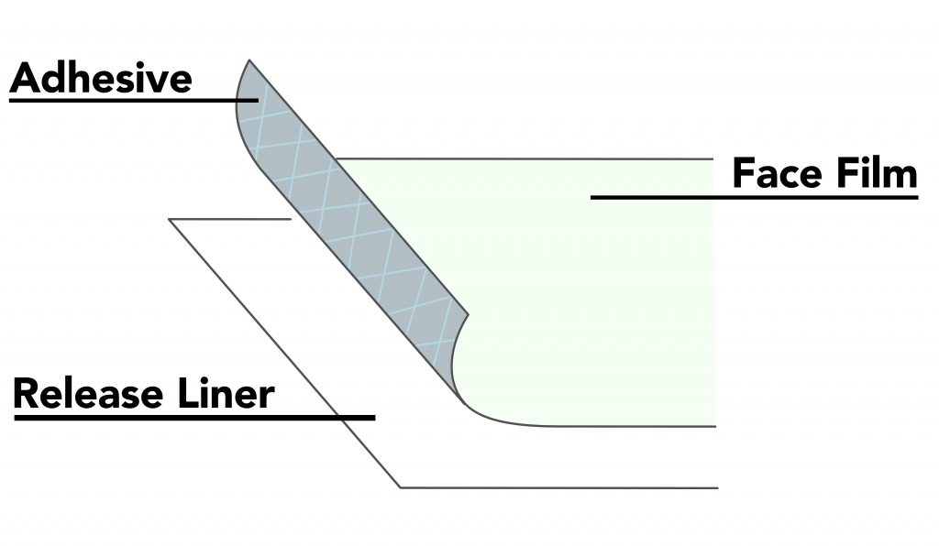
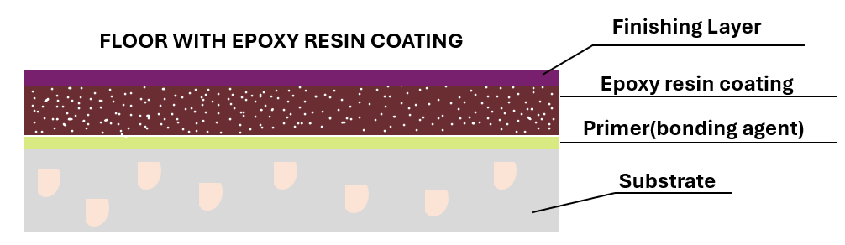
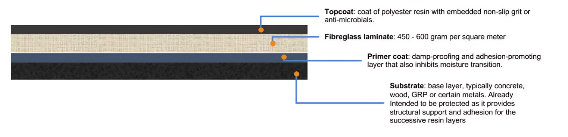
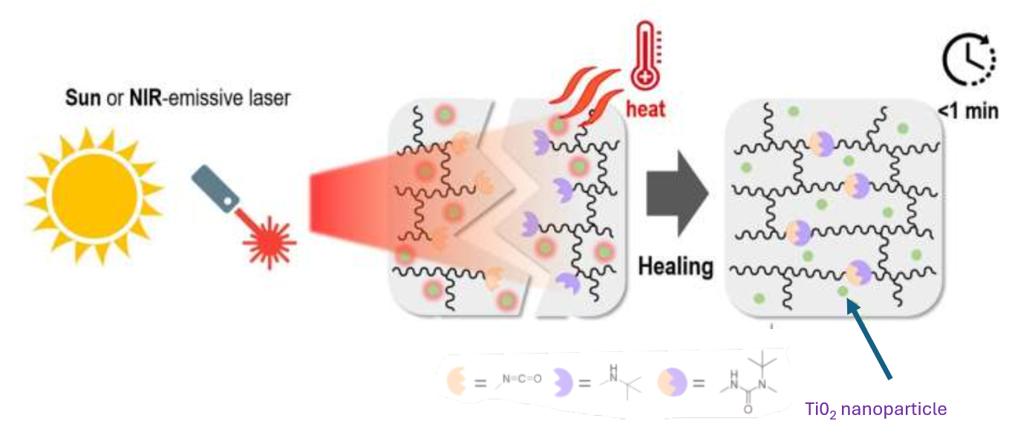
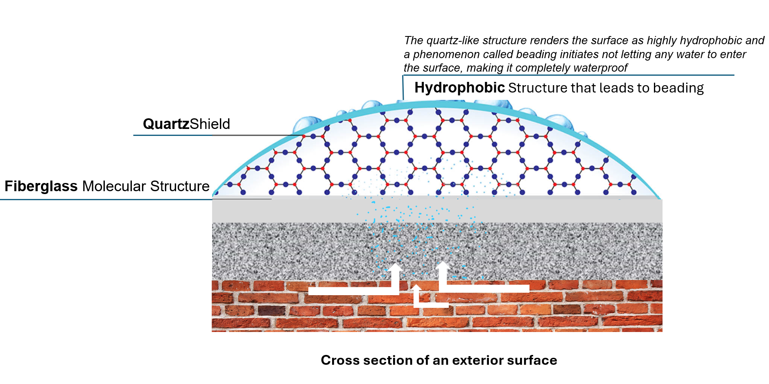
Q.3) Explain the proposed synthetic/processing route in detail of your proposed system along with the raw materials required?
Raw Materials Needed
Release liner: Silicone-coated paper or polymer-based liners.
Epoxy Primer: Epoxy resin. Zinc phosphate for anti-corrosion properties.
Fiberglass Reinforcement: Fiberglass mat or woven fabric. Resin binder (e.g., polyester or epoxy resin).
Self-Healing Coat: Polyurethane. Healing agents-contained microcapsules such as reactive resin, TiO₂ for thermal activation
Quartz Shield Layer: Quartz composites, Fiberglass dioxide for hydrophobic properties
Cap Sheet: Durable polymer or protective film.

Slide 7
Q.4) Please specify detailed application technique of the coating (method of application of full system: undercoat and topcoat application tools: brush/spray/roller/dip coating etc. and specify the substrate)
Surface Pre-Treatment
Substrate: Steel, concrete, or reinforced construction surfaces prone to corrosion.
Treatment:
Use sandblasting (e.g., silica sandblasting) for rust removal.
Use chemical cleaning (e.g., trisodium phosphate - TSP) for grease and dirt removal.
Condition: Ensure surfaces are clean, moisture-free, and prepared for good adhesion.
Priming (Base Coat)
Material: Zinc phosphate epoxy resin primer.
Purpose: Bonds strongly with the substrate.
Provides corrosion protection.
Tools: Brush: For small, detailed areas (e.g., corners).
Spray: For large or curved surfaces requiring uniform coverage.
Roller: For rapid application on flat surfaces like walls or roofs.
Application: Apply a uniform coat using the selected tool.
Cure under ambient or controlled temperature/humidity as recommended
Release Liner Placement
Material: Silicone-coated paper or polymer-based liner.
Purpose: Prevents premature adhesion and facilitates easy handling.
Tools: Manual application (no special tools required).
Application: Place the liner carefully over the cured primer layer.
Ensure no wrinkles or air pockets are present.
The liner should peel off cleanly for subsequent layer application.
Healing Layer Fabrication
Material: Polyurethane matrix with microcapsules containing TiO₂.
Purpose: Repairs scratches and cracks through thermal activation.
Tools: Spray: Ensures even layer distribution for optimal healing.
Dip Coating: Suitable for small components needing full coverage.
Application:
Mix microcapsules into the polyurethane matrix.
Apply as a uniform layer.
Cure thermally or at ambient temperature
to activate the self-healing mechanism.
Quartz Shield Coating
Material: Quartz composites with fiberglass dioxide.
Purpose: Provides water resistance, microbial protection, and salt/alkali resistance.
Tools: Spray: Uniform coverage on complex surfaces.
Roller: Ideal for flat and horizontal surfaces like walls.
Application: Apply the quartz shield layer evenly using the selected tool.
Cure as per manufacturer’s instructions to ensure optimal water resistance.
.
Tools and Substrate Summary
Undercoat Tools: Brush, spray, roller (based on surface size and complexity).
Topcoat Tools: Brush, spray, roller, or dip coating for desired finish.
Suitable Substrates: Metal (e.g., steel, aluminium), concrete, or other solid materials exposed to environmental degradation and corrosion.
Hydrophobic Topcoat Application
Material: Hydrophobic quartz composites with advanced additives.
Purpose: Increases water resistance and protects against environmental abrasion.
Tools: Brush: For critical areas prone to water penetration.
Spray: For smooth, non-porous finishes on large surfaces.
Roller: For fast application on flat horizontal and vertical surfaces.
Application: Apply the hydrophobic topcoat as the final layer.
Allow proper curing as recommended to achieve peak performance.
End Cap Sheet Covering
Material: Durable protective sheet or film.
Purpose: Protects the coating layers during handling, transport, and storage.
Tools: Manual hand overlay (no special tools required).
Application: Cover the fully cured layers with the cap sheet.
Remove easily during the final installation step

Slide 8
Q.5) What can be the challenges that you might face during the development for your coating system and their possible solutions?
Material Compatibility
Challenge: Ensuring perfect bonding between layers to prevent delamination.
Solutions:
Conduct adhesion tests (e.g., cross-cut, pull-off).
Use silane coupling agents for improved interlayer bonding.
Optimize curing schedules for temperature and humidity control.
High Initial Costs
Challenge: Expensive materials and processes increase upfront costs.
Solutions:
Bulk procure materials to reduce expenses.
Develop cost-effective alternatives (e.g., recycled quartz).
Highlight long-term savings through reduced maintenance.
Efficiency in Self-Healing
Challenge: Maintaining reliable self-healing under varying conditions.
Solutions:
Optimize microcapsule formulation for controlled agent release.
Test under real-world stimuli like temperature changes.
Use advanced encapsulation for long-term durability.
Durability in Harsh Environments
Challenge: Ensuring performance in UV, humidity, and chemical exposure.
Solutions:
Add UV stabilizers and corrosion inhibitors.
Perform accelerated aging tests (e.g., UV, salt spray).
Use sacrificial layers for extreme conditions.
Surface Preparation Issues
Challenge: Ensuring clean, prepared substrates for optimal adhesion.
Solutions:
Use sandblasting for rust and TSP cleaning for contaminants.
Verify surface readiness with roughness measurements.
Train teams to maintain surface preparation standards.
Complex Application Process
Challenge: Achieving consistent thickness and quality across multiple layers.
Solutions:
Use spray guns or robotic applicators for uniform application.
Implement quality checks for thickness and surface uniformity.
Train teams or automate processes to minimize errors.
Environmental Issues
Challenge: Reducing VOC emissions and material waste.
Solutions:
Use low-VOC, water-based formulations.
Make materials recyclable or biodegradable.
Optimize processes to minimize overspray and waste.
Market Acceptance
Challenge: Convincing stakeholders to adopt new technology.
Solutions:
Highlight benefits through pilot projects and demonstrations.
Emphasize long-term advantages over traditional methods.

Slide 9
Q.6) What are the boundary conditions of the product (please specify conditions under which it will work and where it will not work)
Conditions Under Which the Coating Will Function
Temperature Range:
Optimal: 0°C to 70°C; self-healing activates through thermal stimuli.
Environmental Exposure:
UV Resistance: Stabilizers prevent UV degradation.
Water Resistance: Quartz Shield and hydrophobic layers offer superior moisture protection.
Corrosion Resistance: Zinc phosphate primer forms a sacrificial anti-corrosion layer.
Pollutant Tolerance:
Capable of degrading organic pollutants through photocatalytic and hydrophobic mechanisms.
Substrate Types:
Works effectively on concrete, metal, and non-porous substrates after proper surface preparation (sandblasting/chemical cleaning).
Mechanical Damage:
Self-healing layers repair microcracks under pressure and temperature stimuli.
Conditions Under Which the Coating Will Not Function
Extreme Temperatures:
Below 0°C: Microcapsules lose flexibility, deactivating self-healing.
Above 70°C: Polyurethane degrades under excessive heat.
Mechanical Abrasion:
Prolonged heavy wear or constant traffic can cause permanent damage.
Chemical Exposure:
Strong acids/alkalis weaken hydrophobic and self-healing properties.
Organic solvents may degrade the polymer matrix.
Surface Preparation:
Improper cleaning (oil, rust, old paint) causes adhesion failures or delamination.
Submersion:
Not suitable for continuous water immersion (e.g., underwater pipelines).

Slide 10
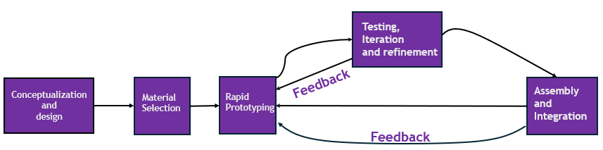
Q.7) What are the facilities required for prototype development, characterization, and testing? What will be the estimated timeline and milestones for development?
Prototype Development Facilities with Integrated Smart IT
Material Preparation:
Facilities: High-shear mixers and ball mills for precise blending and dispersion. Storage facilities with real-time inventory monitoring via ERP and MES systems for material availability and quality checks.
Smart IT Integration: Use automated inventory management within the ERP (Enterprise Resource Planning) layer to track raw material usage and maintain stock levels.
MES (Manufacturing Execution System) integration to track batch production and provide real-time alerts for material shortages.
Purpose: Optimize raw material handling and reduce waste by linking consumption data with production scheduling.
Coating Application:
Facilities: Spray guns, robotic applicators, and controlled curing chambers. Automated robotic arms for consistent multi-layer application.
Smart IT Integration: MES layer manages application precision by controlling parameters such as layer thickness, curing time, and temperature. Automated data logging ensures traceability of each batch for quality assurance.
Purpose: Achieve consistency across layers and batches by monitoring process control parameters.
Characterization Facilities with Smart IT Integration
Adhesion Testing:
Facilities: Pull-off adhesion testers and cross-hatch cutters.
Smart IT Integration: Automated data capture using sensors linked to MES for centralized storage of test results.
Purpose: Improve data accessibility for performance trend analysis.
Surface Analysis:
Facilities: SEM and AFM systems for morphology and roughness evaluation.
Smart IT Integration: Data integration with MES for instant defect reporting and process adjustments.
Purpose: Minimize errors by linking real-time characterization data to manufacturing parameters.
Chemical and Thermal Analysis:
Facilities: FTIR and DSC for composition and stability testing.
Smart IT Integration: MES provides automated alarms for deviations in chemical or thermal properties.
Purpose: Enhance batch consistency and quality.
Self-Healing Validation:
Facilities: Environmental chambers and microscopy systems.
Smart IT Integration: Test data is fed back into MES for process optimization and predictive analytics.
Purpose: Monitor long-term self-healing performance under various conditions.

Slide 11
Q.7) What are the facilities required for prototype development, characterization, and testing? What will be the estimated timeline and milestones for development?
Testing Facilities with Smart IT Integration
Testing Facilities with Smart IT Integration
Durability and Environmental Resistance:
Facilities: UV-accelerated aging chambers and salt spray testers.
Smart IT Integration: MES automatically correlates durability results with production parameters to optimize formulations.
Purpose: Proactively refine production processes to enhance environmental resistance.
Mechanical Testing:
Facilities: Abrasion and tensile testers.
Smart IT Integration: MES and PDA systems enable automated defect reporting and batch rejection alerts.
Purpose: Ensure coating reliability under stress conditions.
Hydrophobic Testing:
Facilities: Contact angle goniometers and water spray testers.
Smart IT Integration: Results directly inform MES, which adjusts hydrophobic additive formulations for better performance.
Purpose: Optimize water-resistance properties during production.
Estimated Timeline and Milestone Table
Activity
Milestone
Time Required
Formulations validated through
lab-scale tests
Product Development & Testing
Milestone
2 Months
Time Required
Activity
Premises ready with utilities and
infrastructure
Pilot Production
1–2 Months
1–1.5 Months
Site Acquisition and Preparation
Trial production runs completed
Procurement of Plant and
Machinery
Testing protocols and equipment
established
Machinery sourced with vendor
support
1 Month
Quality Control Setup
2–3 Months
Equipment installed and
calibrated
Process validated; feedback
incorporated
Commercial Trial Runs
Installation of Machinery
1–1.5 Months
2–3 Months
Financing secured for operations
and materials
Branding materials and
promotional activities completed
1–2 Months (Concurrent)
1–2 Months (Concurrent)
Arrangement of Finance
Marketing & Branding Initiatives
Environmental and safety
approvals obtained
Regulatory Approvals and
Certifications
Reliable suppliers identified;
materials sourced
1 Month
2–3 Months
Raw Material Procurement
After 6 Months
Skilled workforce trained and
onboarded
Manpower Recruitment and
Training
Full-Scale Production & Launch
1–2 Months
Product launched in key markets

Slide 12
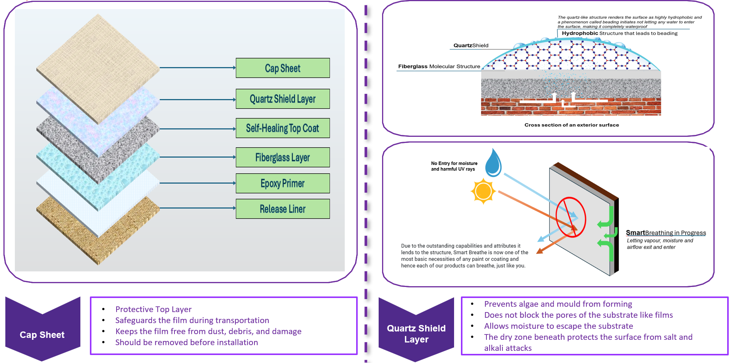
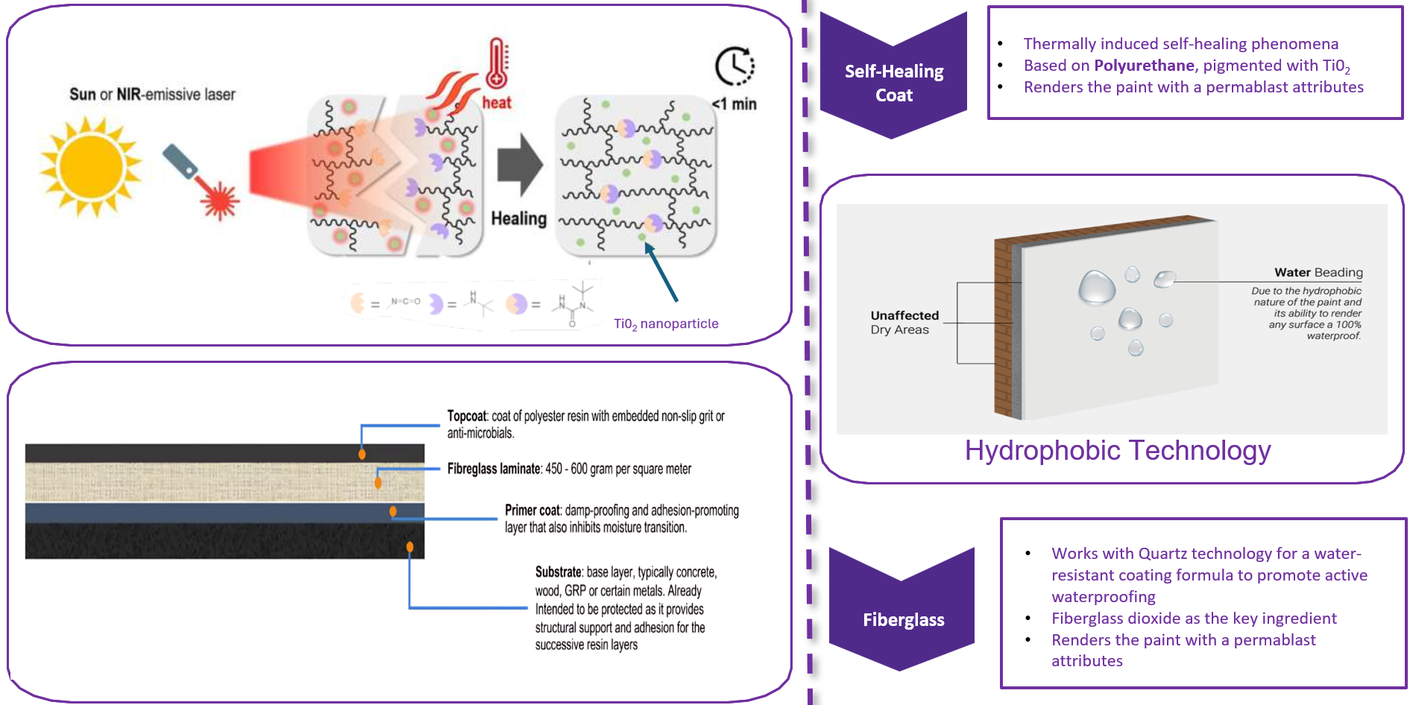
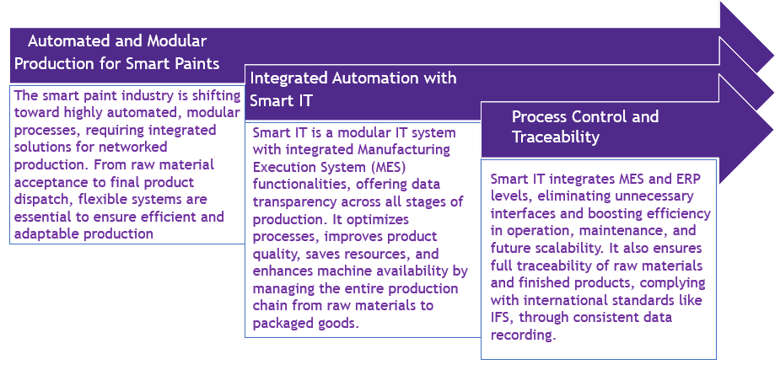
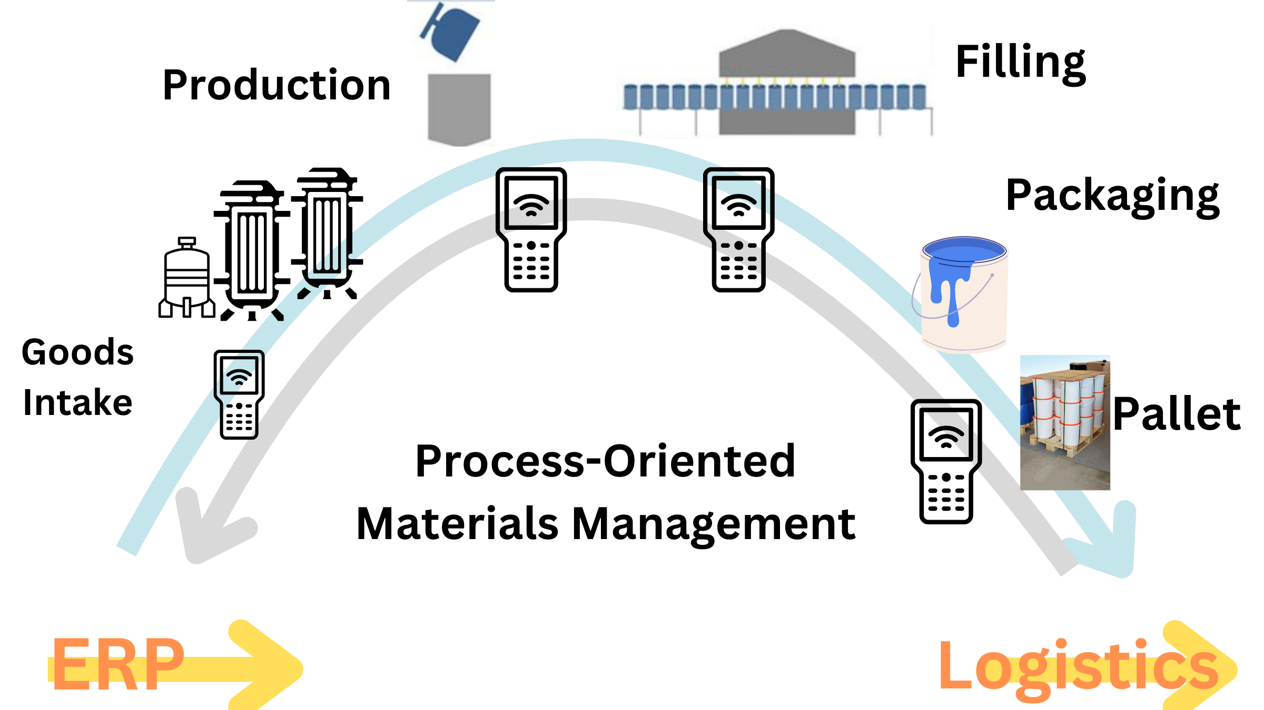
Q.8) Preferably share the proof of concept/prototype to demonstrate your proposal

Slide 13
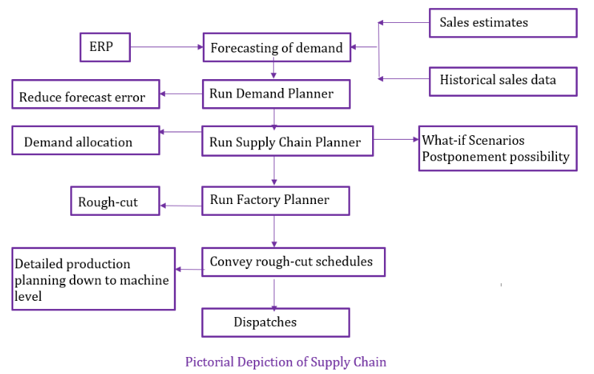
Q.9) Give your perspective on the scalability from lab to bulk scale
Manufacturing Process Optimization
Packaging and Storage
Procurement of Materials
Product Testing and Quality Control
Challenges:
Ensuring the consistent quality of raw materials.
Managing large-scale procurement and supply chain risks.
Solutions:
Establish contracts with trusted suppliers to guarantee material uniformity.
Implement a Demand Planner to accurately forecast raw material requirements and reduce excess inventory.
Lab Scale: Hand-applied coatings under controlled conditions.
Bulk Scale: Use of high-capacity mixers, automated spray systems, and continuous production lines.
Challenges: Uniform application across large areas or batches. Minimizing variability in curing and drying times.
Solutions: Supply Chain Planner: Allocates production optimally based on cost and inventory levels.
Factory Planner: Generates detailed week-to-week production plans, ensuring efficient resource utilization.
Lab Scale: Rigorous testing of small quantities for adhesion, durability, and self-healing.
Bulk Scale:
Real-time testing for inline batch consistency using advanced QC equipment.
Automated robotic systems for testing adhesion, thickness, and hydrophobicity.
Solutions: Use Optimal Scheduler for real-time monitoring, reducing inefficiencies, and improving throughput.
Develop simplified yet robust QC protocols suitable for bulk processes.
Lab Scale: Stored in small vials for immediate use.
Bulk Scale: Use industrial storage tanks and efficient packaging systems (e.g., bulk totes).
Challenges: Maintaining formulation stability and preventing contamination.
Solutions: Add stabilizers for extended shelf life; use sealed, inert storage systems.
Environmental and Safety Compliance
Economic Viability
Logistics and Distribution
Lab Scale: Minimal waste with negligible environmental impact.
Bulk Scale: Adhere to safety regulations (e.g., VOC limits, waste management); mitigate workplace hazards.
Challenges: Managing VOC emissions and chemical waste; training personnel.
Solutions: Switch to low-VOC formulations; implement waste protocols and conduct staff training.
Lab Scale: Focus on functionality over cost.
Bulk Scale: Conduct techno-economic evaluations and leverage economies of scale.
Challenges: Balancing initial investments with long-term gains; justifying costs to stakeholders.
Solutions: Pilot-scale trials for optimization; emphasize long-term benefits like reduced maintenance costs in marketing strategies.
Logistics and Distribution
Efficient logistics are critical for bulk-scale success.
Solutions: Implement a Supply Chain Management (SCM) system to optimize logistics costs while ensuring rapid replenishment.
Use "postponement" strategies to keep the product in a flexible state until closer to the customer, reducing warehousing and logistics challenges.

Slide 14
Q.10) Please give a business case (feasibility, customer, cost) for your system
Equipment
Purpose
Unit
Price (INR)
Industrial Setup Requirements
1. Area Requirements:
Total Area: 1500–2000 Sqft.
Inventory storage.
Workshop/manufacturing area.
Power supply utilities (e.g., generator setup).
Office space for staff, documentation, and furniture.
Civil Work Cost: Approx. ₹3,00,000.
2. Power Requirements:
Total Power Requirement: 112 HP.
Peak Power Range: 205 HP.
Recommended Motor Power: 250 HP.
3. Industrial Electric Motors:
Motor Type: Squirrel Cage Induction Motor (Three-phase AC motor).
Power Range: Up to 500 HP.
1
Grinding quartz and TiO₂ into
fine particles
Ball Mill
8,00,000–10,00,000
1
Blending quartz, TiO₂, polyurethane,
and epoxy resin
High-Shear Mixer
4,00,000–6,00,000
1
Ensuring uniform dispersion of
pigments and additives
4,00,000–7,00,000
Bead Mill
1
Mixing fiberglass and polymer
materials
6,00,000–8,00,000
Extruder
1
Degassing the mixture to remove
air bubbles
3,00,000–4,00,000
Vacuum Mixer
2
Applying quartz or polyurethane-
based coatings uniformly
40,000–80,000 per unit
HVLP Spray Gun
1
Curing quartz, self-healing topcoat,
and epoxy layers
6,00,000–9,00,000
Industrial Conveyor Oven
1
Measuring coating thickness for
quality assurance
Film Thickness Gauge
Concurrent Activities for the Industrial Setup
1. Finance Management:
Can occur alongside site acquisition and machinery procurement to ensure timely budget allocation and payments.
2. Manpower Training:
Can run parallel with the installation of machinery to prepare the workforce for operating and maintaining equipment efficiently.
3. Marketing Activities:
Can be initiated during product testing and pilot production to build brand awareness and plan promotional strategies for market entry.
80,000–1,50,000
1
Preparing surfaces to enhance
coating adhesion
2,50,000–4,00,000
Sandblasting Machine
1
Ensuring proper viscosity for
sprayable coatings
Viscosity Control System
1,50,000–2,50,000
1
Mixing and dispersing epoxy
primers
Epoxy Dispensing System
2,50,000–4,00,000
1
Controlling polymerization reactions for self-healing properties
Polymerization Reactor
8,00,000–12,00,000
1
Cutting fiberglass into required sizing
for mixing
Fiberglass Chopper
1,50,000–3,00,000
Please refer the excel sheet : https://tinyurl.com/4dm9du6n

Slide 15
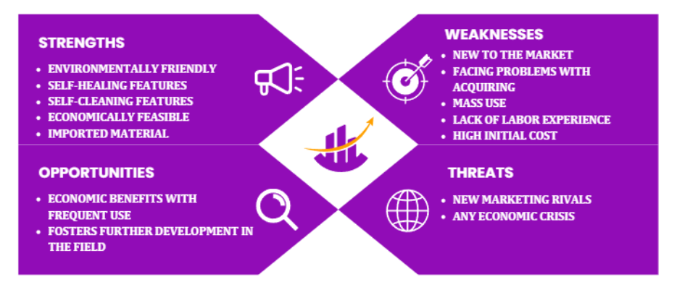
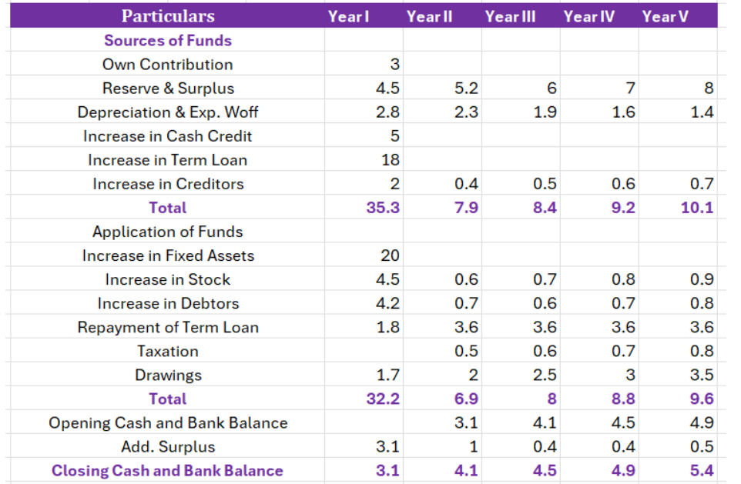
SWOT Analysis
Economic Feasibility
The economic feasibility comparative study illustrates that for a useful life of 20 years, The Smart Coatings would present a saving of ~ 81% in comparison to the ordinary coatings. This makes it the better option when choosing a coating material for a building, in addition to its previously discussed benefits
Projected Cash Flow Statement
Item | Alternative 1 in Rs (Acrylic) | Alternative 2 in Rs (Smart Coating)
Initial Cost | 111.3 | 235.85
Total Initial Cost | 17,808 | 37,736
Useful Life | 20 Years | 20 Years
Maintenance Annual Cost | 89,040 | 12,720
PW of Maintenance Annual Cost | 664,840.88 | 95002.32
Net Present Worth | 682,648.88 | 132,738.32
SAVINGS |  | 549,910.56

Slide 16


GO TO MARKET STRATEGY
Phase 1
Phase 2
Q1
Q2
Q3
Q4
Q1
Q2
Q3
Q4
Product Innovation and Awareness
Expansion & Market Penetration
Build Brand Loyalty
Long term Brand Building
1. Launch product
2.Conduct live demos
3.Initiate digital campaigns
4.Introduce localized product variants
5. Launch educational webinars
1. Collaborate with architectural firms
2. Launch products through pilot distributors
3. Expand into Tier 2 and Tier 3 cities
4. Form partnerships with regional paint retailers
5. Provide exclusive training workshop
1. Loyal reward program
2. Customer support helpline
3. Highlight success stories
4. Contractor certification
program
5. Develop a dedicated app
1. Gather feedback from customers
2. Brand narrative on sustainability
3. Annual Asian Paints innovation summit
4. Additional product lines
Brand Communication Plan for Smart Paint
Innovation
Brand Engagement Activities
Make your walls look SMART
Science in every stroke
Sustainable innovations
Interactive VR/AR Demos
Host innovation days
Launch a dedicated mobile app for colour customization and tips
Engage followers with live Q&A sessions
Run contests for contractors and consumers
Partner with eco-focused NGOs for initiatives
Launch social campaigns like #SmartPaintRevolution
Key Brand Values: innovation, Sustainability
Functional Benefits
High Durability
Eco-Friendly
Performance

Slide 17
References
1. Asit Baran Samui, Sushil S. Pawar: Chapter 3 – Smart Paints
2. Corrosionpedia. “Definition of Smart Coatings” (2017). Available at: https://www.corrosionpedia.com/definition/5965/self-curing-coating Accessed (10/9/2017)
3. International Group of Modern Coatings (IGMC). “MIDO Coatings”,(2017)
4. Abdelaziz F. Mohamed. “Hybrid Nano-Crystal PV/Wind Turbine Power Generation System in Buildings”
5. DYNOLITE – Datasheet
6. NANOMYTE MEND 1000 TDS – Datasheet
7. Decora Acrylic Emulsion – Datasheet
8. Handbook for smart coating by Abdel Salam Hamdy Makhlouf
9. M. Shafique, A. Azam, M. Rafiq, M. Ateeq, X. Luo, An overview of life cycle
assessment of green roofs, J. Cleaner Prod. 250 (2020) 119471, https://doi.org/10.1016/j.jclepro.2019.119471.
10. S. Pushkar, Life cycle assessment of flat roof technologies for office buildings in Israel, Sustainability 8 (1) (2016) 54.

